Slide 1
Data Visualization
By Ghazali Akmal Rabbani

Slide 2
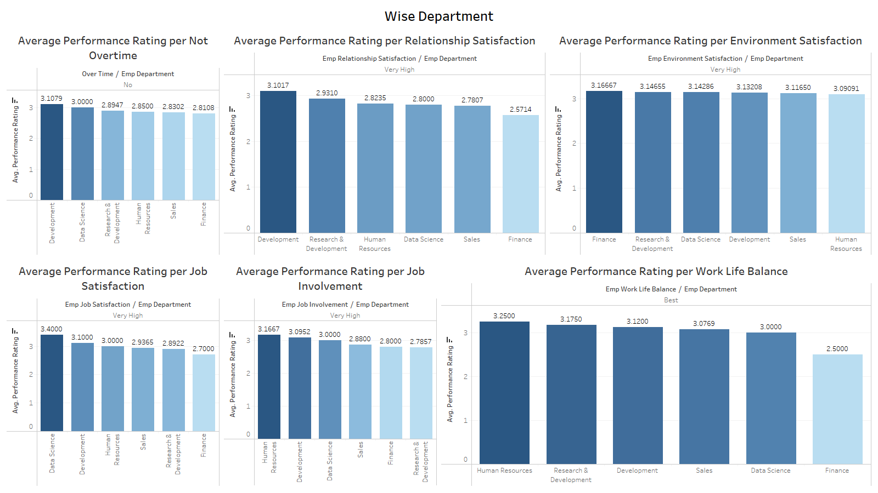

Slide 3
